Slide 1
DESIGN AND ANALYSIS OF ALGORITHMS
Dijkstra's
Algorithm
CORE IDEA
Shortest paths
Presented by
Riddhi Thorat - 25070521246
One greedy choice at a time.
Symbiosis Institute of Technology Nagpur

Slide 2
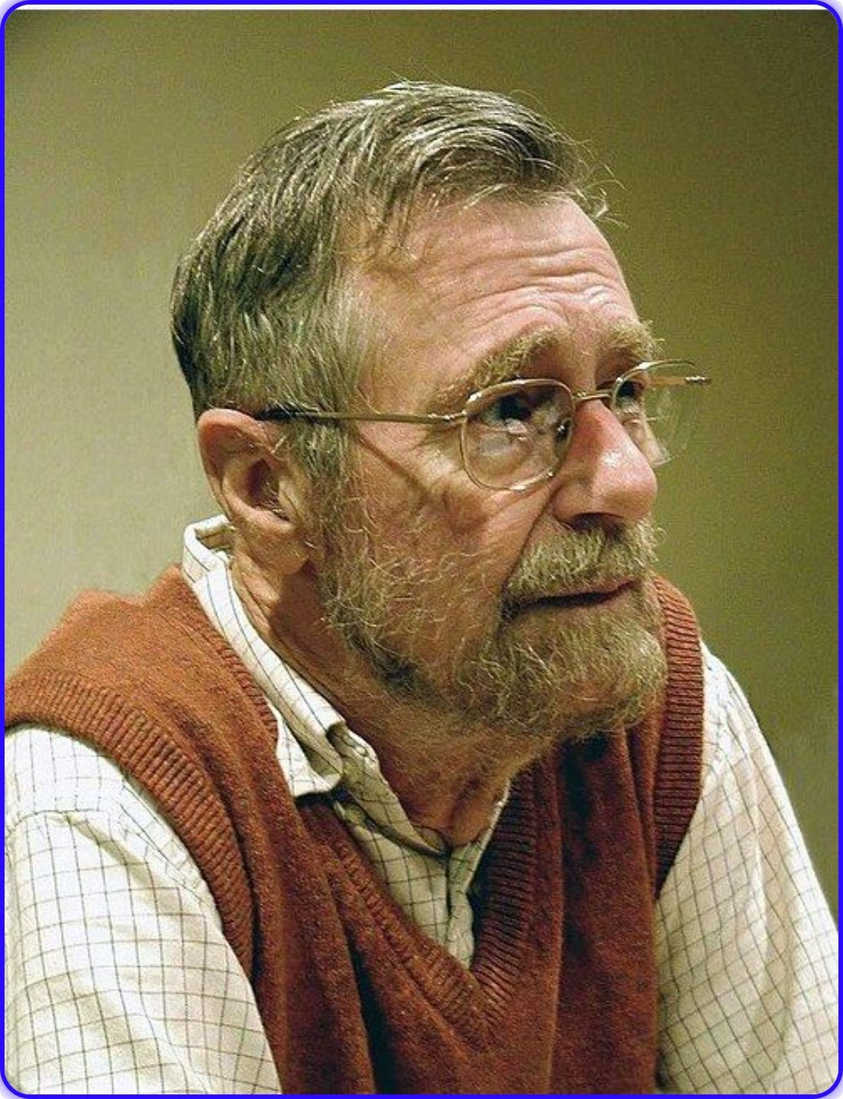




ORIGIN AND LEGACY
From a 1956 idea to a classic algorithm
Designed in 1956 and published in 1959 by Dutch computer scientist Edsger W. Dijkstra.
He won the Turing Award in 1972.
The Edsger W. Dijkstra Paper Prize in Distributed Computing carries his name.
“Computer Science is no more about computers than astronomy is about telescopes.”

Slide 3
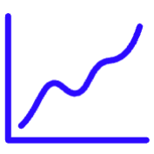


PROBLEM AND MODEL
Shortest paths, one greedy choice at a time
Dijkstra solves a single-source shortest path problem.
Input
Output
Example
Weighted graph G = {V, E}, non-negative edge weights, and a source vertex.
Shortest distance from the source to every other vertex.
Cities are vertices; driving distances are edge weights.
Unlike an MST: Dijkstra minimizes distance from one source; an MST minimizes total tree weight.

Slide 4
The workflow: initialize, choose, relax, repeat
Set source distance to 0; all others to ∞.
Keep a visited set.
Pick unvisited node with smallest distance.
Mark it visited.
Relax every neighbor using d[u] + weight.
Update when the new distance is smaller.
Repeat until all nodes are visited.
SHORT PSEUDOCODE
dist[s] = 0
while unvisited:
u = minDist()
visit(u)
for each v:
relax(u, v)

Slide 5
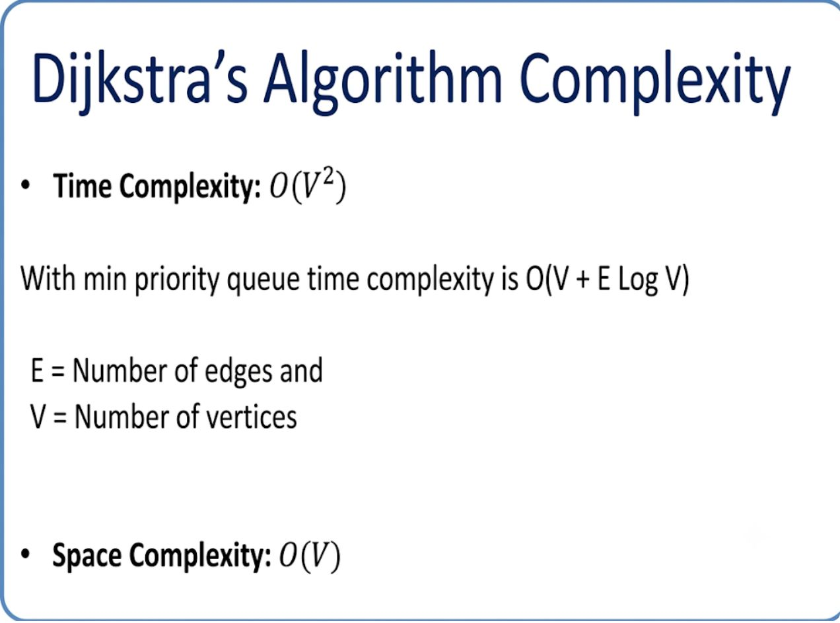
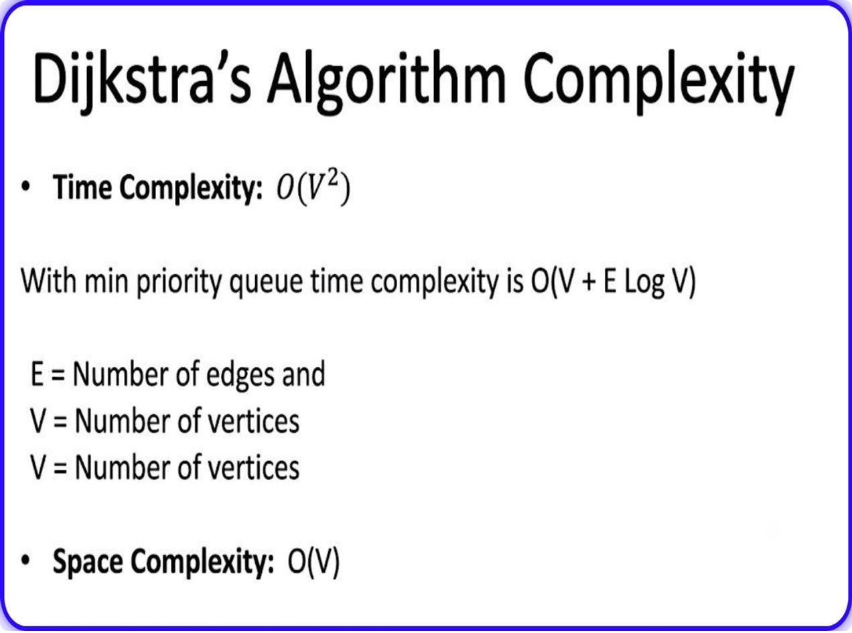
PERFORMANCE
Complexity depends on the data structure
Implementation | Time | Space
Adjacency matrix | O(V²) | O(V)
Priority queue / min-heap | O((V + E) log V) | O(V)
Sparse-graph shorthand | O(E log V) | O(V)
Use the matrix for dense graphs; use a min-heap to prioritize the next closest vertex.

Slide 6
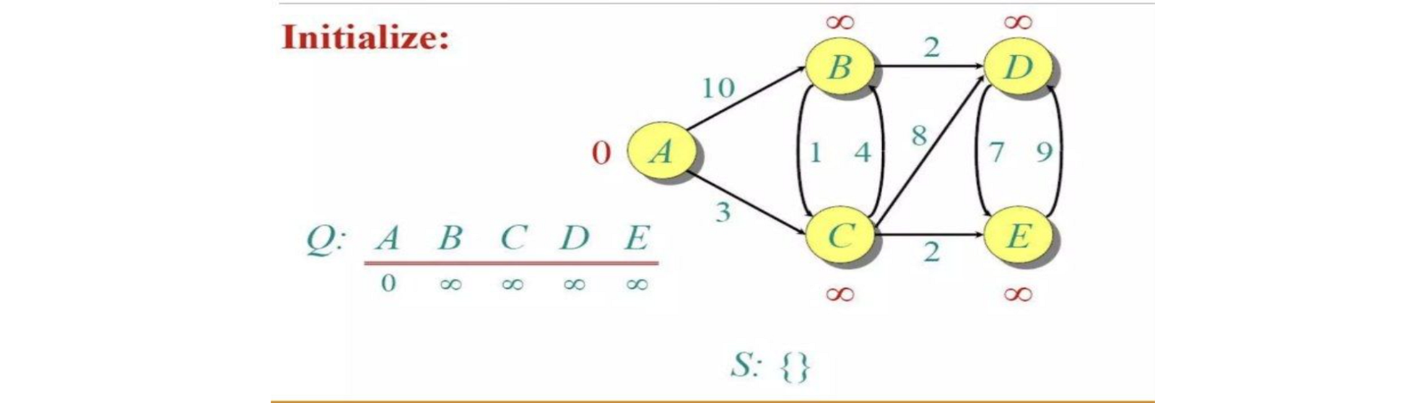
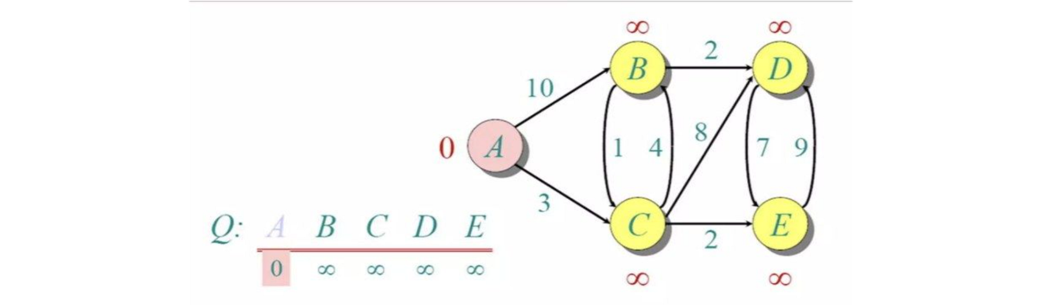
WORKED EXAMPLE · FIRST PASS
Worked example: the first labels emerge
Start at A with d(A)=0 and all other distances at ∞.
Visit A: relax A→B = 10 and A→C = 3.
Visit C next: improve B to 7; set D to 11 and E to 5.
Keep the smallest tentative label as the next greedy choice.

Slide 7
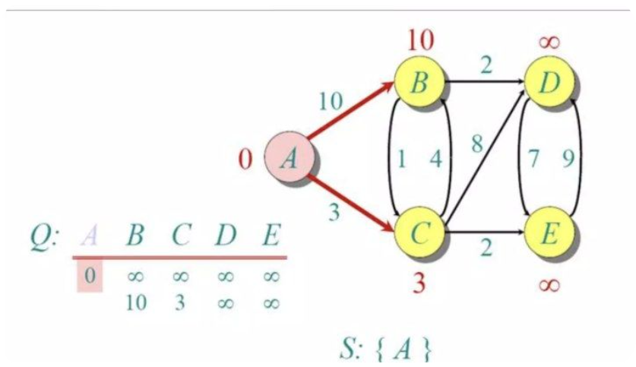
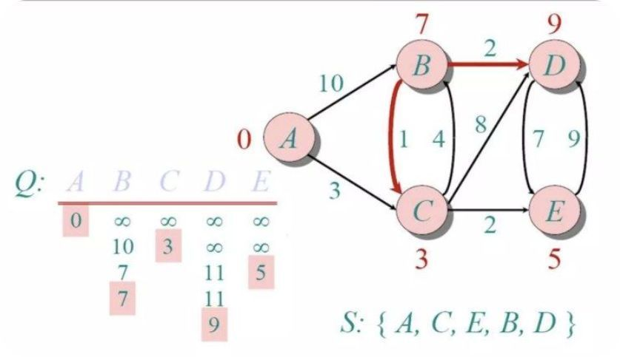
WORKED EXAMPLE · FINAL PASS
Worked example: finalize distances and paths
After C, E, B, and D are selected, every shortest label is final.
Final distances from A: A=0, C=3, E=5, B=7, D=9.
Shortest-path tree: A→C, C→E, C→B, B→D.
The predecessor links explain not only how far, but how to reach each destination.

Slide 8
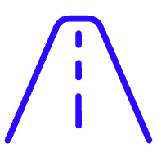

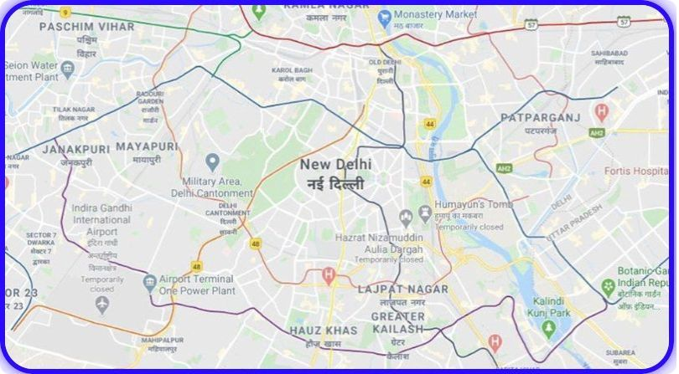
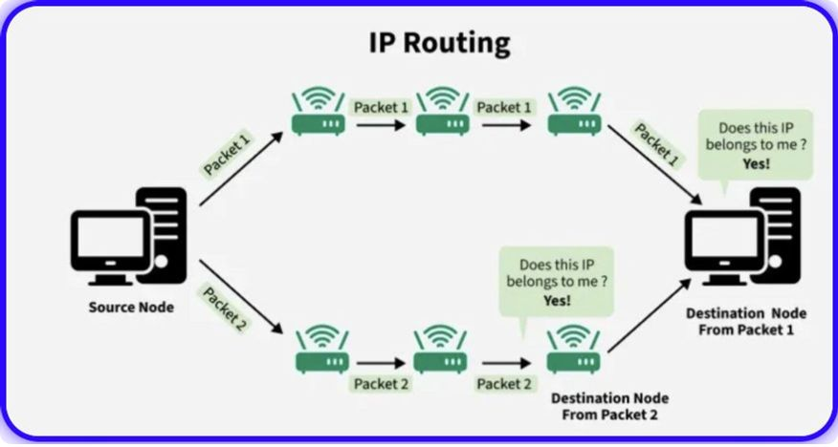
APPLICATIONS
Applications: maps and routing
Digital mapping
IP routing
Junctions = vertices; roads = edges; time or distance = weights. Live traffic triggers recalculation.
Routers = vertices; network links = edges. OSPF updates routing tables using shortest paths.

Slide 9




APPLICATIONS
Applications: people and telephone networks
Social networking
Telephone networks
People are vertices; relationships are edges; degrees of connection support “People You May Know.”
Towers or exchanges are vertices; cables are edges; signal delay is the weight; shortest paths support bandwidth optimization.

Slide 10
WHEN TO USE IT
Use it when weights are non-negative
Advantages
Disadvantages
Guaranteed shortest path; works on directed and undirected graphs; finds all destinations in one run; fast with a priority queue.
Fails with negative edges; blind search can explore many nodes; needs O(V) memory; can be slow on dense graphs; must be rerun when the graph changes.
TAKEAWAY
Dijkstra turns local greedy choices into globally shortest paths.

Slide 11
Thank You
Made with GAMMA

